Slide 1
Portable Gas Detection Overview
Honeywell Analytics Portable Gas Detection
Arturo Moran 210-328-9952
Arturo.moran@honeywell.com

Slide 2
Why is gas detection important ?
Notes:
BP Texas City
Gas Safety is a life safety device. Its an electronic piece of equipment. Many just throw their monitors in their trucks, and allow them to sit in the sun and heat or cold. We don’t treat our cell phones this bad. Make sure to properly maintain your personal gas monitor, so that, you may go home safely every day.

Slide 3
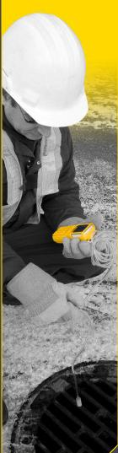
Why Are Portable Gas Detectors Used?
Confined Space Regulations (29 CFR 1910.146)
Protect personnel
Protect infrastructure
Protect the environment
Gather evidence
Maintain legal compliance
Control processes and gather data
Improve productivity
Confirm that an area can be occupied
65% of confined space fatalities are caused by air quality problems
In almost all of these cases, the air was never monitored
29% of workers that die in confined spaces are supervisors, foremen, and managers
60% of workers who die in confined spaces are rescuers
                2010 data

Slide 4
3 basic types of atmospheric hazards
Oxygen (deficiency and enrichment)
Flammable gases and vapors
Toxic contaminants
Notes:
We will cover: 3 basic types of atmospheric hazards: O2, Combustible gases, and toxins.

Slide 5
Oxygen Deficiency
Notes:
Oxygen Deficiency. Why do we care? Human life.

Slide 6
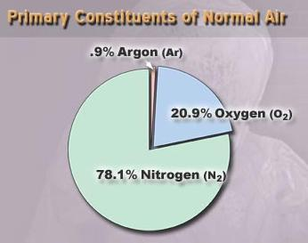
Composition of fresh air
78.1 % Nitrogen
20.9 % Oxygen
0.9 % Argon
0.1 % All other gases
  Water vapor
  CO2
  Other trace gases
Notes:
The composition of O2 in fresh air is 20.9%.

Slide 7
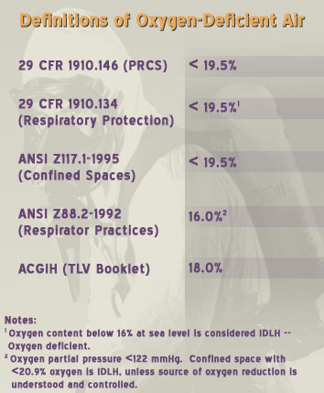
Oxygen Deficiency
Most widely accepted definition: Air is oxygen deficient whenever concentration is less than 19.5%
Notes:
Most widely accepted definition: Air is oxygen deficient whenever concentration is less than 19.5%

Slide 8

O₂ vs. % Vol at Varying Altitudes
Height
Atm. Pressure
PO₂
Con.
feet
meters
mmHg
mmHg
kPa
% Vol
16,000
4,810
421.8
88.4
11.8
20.9
10,000
3,050
529.7
111.0
14.8
20.9
5,000
1,525
636.1
133.3
17.8
20.9
3,000
915
683.3
143.3
19.1
20.9
1,000
305
733.6
153.7
20.5
20.9
0
0
760.0
159.2
21.2
20.9
19.5% O₂ at sea level = 18 kPa
Notes:
There is a misnomer that their is less % of O2 at higher altitudes, but in fact, there is just less air.

Slide 9
Oxygen Deficiency
Occurrence associated with:
  Confined spaces
  Unventilated cellars
  Sewers
  Wells
  Mines
  Ship holds
  Tanks
  Enclosures containing inert atmospheres
Notes:
Oxygen deficiencies happen in many places>>Cellars, frac tanks

Slide 10
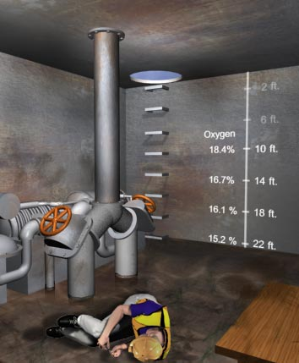
Causes of Oxygen Deficiency
Displacement
Microbial action
Oxidation
Combustion
Absorption
Notes:
How? Displacement-another gas comes in. Microbial- bacteria consumes it. Rust causes oxidation.

Slide 11
Oxygen displacement in open topped confined space
Argon
Notes:
This is an example of an open space displacement. In an open space, gas may settle still.

Slide 12
Symptoms of Oxygen Deficiency
20.9 %
Oxygen content in fresh air
19.5 % - 12 %
Impaired judgment, increased pulse and
respiration, fatigue, loss of coordination
12 % - 10 %
Disturbed respiration, poor circulation,
worsening fatigue and loss of critical faculties,
symptoms within seconds to minutes
10 % - 6 %
Nausea, vomiting, inability to move, loss of
consciousness, and death
6 % - 0 %
Convulsions, gasping respiration, cessation of
breathing, cardiac arrest, symptoms immediate,
death within minutes
Notes:
Another misnomer with some is that they believe that they can use their senses. This is not true. O2 deficiency can occur immediately.

Slide 13
Oxygen Enrichment
Many standards (including USA 29 CFR 1910.146) Specify 23.5 % as oxygen enriched
  Other codes (such as USA 29 CFR 1915 and NFPA guidelines) are more stringent
  More conservative approach is to use 22.5 % as hazardous condition threshold
Notes:
O2 Enrichment- Why do we care if O2 is greater than 23.5%? It is combustible. Remember the ValuJet that crashed into the Florida everglades? There were O2 cylinders in the cargo that caught fire, and exploded.

Slide 14
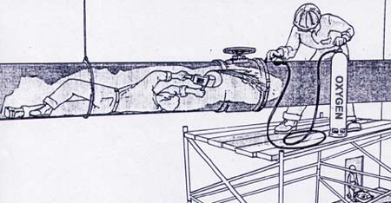
Oxygen Enrichment
Proportionally increases the rate of many chemical reactions
Can cause ordinary combustible materials to become flammable or explosive
Notes:
Also, O2 Enrichment enhances the combustibility of other gases in the space. The combustibility of methane is 5%. In the presence of enriched O2, it may drop to 3%, because O2 has raised the lower explosive limit.

Slide 15
Explosive or Flammable Atmospheres
Notes:
Explosive or Flammable Atmospheres

Slide 16
Lower Explosive Limit (L.E.L.)
Minimum concentration of a combustible gas or vapor in air which will ignite if a source of ignition is present
Notes:
LEL- is the minimum level that something can burn.

Slide 17
Upper Explosive Limit (U.E.L.)
Most but not all combustible gases have an upper explosive limit
  Maximum concentration in air which will support combustion
  Concentrations which are above the U.E.L. are too “rich” to burn
Notes:
UEL- is the maximum level that something can burn.

Slide 18
Flammability Range
Gas Concentration
Flammability
Range
LEL
UEL
The range between the L.E.L. and the U.E.L. of a combustible gas or liquid
Concentrations within the flammable range will burn or explode if a source of ignition is present
Notes:
The flammability level for all combustibles is the range between the LEL and UEL. If you filled a room with methane, and it reaches 5% volume by air, and lit a match, it would blow up! Gas detectors don’t alarm at LEL. Do they? Does anyone know what they alarm at? 10% of the LEL. Why? This is the action limit. This does not mean that you can wait until the LEL reaches 100%. Its time to go.

Slide 19
Common Flammability Ranges
LEL UEL
Methane 5.0 % 15.0 %
Propane 2.2 % 9.5 %
Hydrogen 4.0% 75.0%
Butane 1.8% 8.4%
Pentane 1.4% 7.8%
Ethylene oxide 3.0 % 100.0%
Hydrogen sulfide 4.3 % 46.0%
Different gases have different flammability ranges
Notes:
Methane is the most common, with an LEL of 5%. Pentane is 1.4%. H2S is also combustible, but you are way past the IDLH at that point.

Slide 20
Catalytic “Hot Bead” Combustible Sensor
Detects combustible gas by catalytic oxidation
When exposed to gas oxidation reaction causes bead to heat
Requires oxygen to detect combustible gas!
Notes:
Hot Bead Combustible sensor- The LEL sensor is a Catalytic hot bead sensor is always drawing power. It draws power all of the time, by combusting incoming gases. This is how it determines a readout on the sensor display. If there is not enough O2 present, the LEL sensor will not work properly. Why? Because it can’t burn. Remember the fire triangle. Less than 10% O2 will cause the LEL sensor to not function. For this reason, Honeywell will not manufacture a multi gas monitor that has an LEL sensor without an O2 sensor.

Slide 21
Over-Limit Protection
LEL sensor only designed to detect 0-100% LEL concentration of flammable gas
If O2 concentration less than 10% O2, LEL sensor will not read properly
Also, sensor may be damaged by exposure to higher than 100% LEL concentrations
To prevent damage, sensor is switched OFF and instead of the LEL reading OL = (Over Limit) is displayed.
Notes:
Over-Limit Protection- Has anyone ever seen OL on their LEL sensor? When a monitor goes into OL, it no longer reads combustible gases. You have over ranged the limit of the sensor. Rather than fry the sensor, the monitor shuts it off. You must go to a clean environment, and hope the monitor clears the sensor. It may never clear, and the sensor will need to be replaced. If it does clear, it is highly recommended to calibrate and then bump test prior to use.

Slide 22
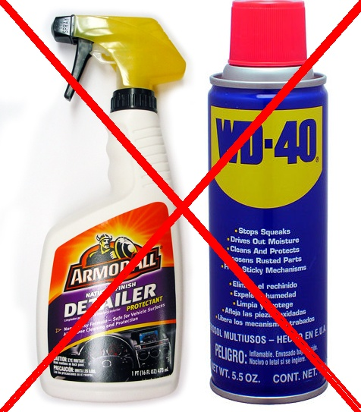
Combustible sensor Poisons
  Silicones
    Lubricants such as WD-40
    Rust inhibitors
    Hand moisturizers
    Hand sanitizers
    Cleaners such as ARMOR ALL
  Hydrogen sulfide and other sulfur containing compounds
  Phosphates and phosphorus containing substances
  Lead containing compounds (especially tetraethyl lead)
  Over Exposure to combustible gases
Notes:
Combustible sensor Poisons- A lot of people use WD40 to clean things. A monitor shouldn’t be one. H2S and LEL sensors will fail. Silicones poison the LEL cat bead sensors. Don’t use solvents or cleaners to clean your monitor. Just use a damp rag.

Slide 23
Toxic Gases and Vapors
Notes:
Toxic Gases and Vapors

Slide 24
Vapor density
Lighter than air
Measure of a vapor’s weight compared to air
Gases lighter than air tend to rise; gases heavier than air tend to sink
Hydrogen
Methane
Ammonia
Propane
Hydrogen sulfide
Gasoline
Heavier than air
Notes:
Some gases are heavier than air, and some are lighter than air, depending on their vapor densities.

Slide 25
Stratification
Atmospheric hazards in confined spaces form layers
Check all levels! Atmosphere tested (at least) a distance of approximately 4 feet (1.22 m) in the direction of travel and to each side
Allow sufficient time for all sensors to react to each sample per level tested. Key response factors are hose length (typical 2 seconds per foot flow rate) plus T90 sensor/s response time. For Example: 10’ hose x 2 seconds = 20 seconds plus most significant T90 of monitor’s sensors (typically 30 seconds for standard 4-gas monitor). (10 x 2) + 30 = 50 seconds per level
Notes:
So we need to understand that some gases stratify depending if they are heavier or lighter than air. So when you are doing a survey of a tank, it is important to check the bottom, middle, and top areas of the tank. Another important thing to consider is response time. It can be calculated as T90= 2s/foot.

Slide 26
Toxic Gases and Vapors
Detection technologies:
  Electrochemical Sensors
  Photoionization detectors
  Non-dispersive infrared (NDIR)
Notes:
Toxic Gases and Vapors- There are three ways currently to detect gases:
Electrochemical is the most common. It has a reservoir of chemicals inside it. The gas comes in. A chemical Rxn occurs, and there is a release of electrons. These electrons go to the board, creating a milliamp output that sends signal to the board.
PID- works by using UV light which ionizes or shatters gas molecules. Depending on the amount of energy needed to do this, it gives a reading to the detector. So with an environment with multiple VOCs, a PID can’t distinguish between the different gases, rather gives a total reading. The PID is a general sensing device.
IR is a fairly new technology that can distinguish between certain VOCs. Also, we are working on some photoacoustic sensors.

Slide 27
Permissible Exposure Limits
“Parts-per-Million” (ppm) concentrations
  1.0 ppm the same as:
    One automobile in bumper-to-bumper traffic from Cleveland to San Francisco
    One inch in 16 miles
    One minute in two years
    One ounce in 32 tons
    One cent in $10,000
Notes:
Permissible Exposure Limits- This slide was to give perspective to what 1ppm is. On a smaller scale, 1 ppb can be compared to one silver dollar out of a billion stretched from SF to NY. When talking about H2S, we can actually smell it at ppb levels.

Slide 28
Carbon Monoxide
Bonds to hemoglobin in red blood cells
Contaminated cells can’t transport O2
Chronic exposure at even low levels harmful
Notes:
Toxic gases- CO- Carbon Monoxide. Raise your hands if you use wood or natural gas to heat your home? Now how many of you have a CO monitor at home? If you don’t have one, please get one. CO is dangerous because it is colorless, and odorless.

Slide 29
Carbon Monoxide
Produced as a by product of incomplete combustion
  Associated with internal combustion engine exhaust
    Vehicles
    Pumps
    Compressors
Notes:
CO comes from incomplete combustion. We see it from, vehicles, pumps, and generators.

Slide 30
Characteristics of Carbon Monoxide
Colorless
Odorless
About the same weight as air
Flammable ( LEL is 12.5 %)
Toxic!
Notes:
CO is colorless, odorless, and flammable. At 12.5%, we have already exceeded the IDLH.

Slide 31
Symptoms of Carbon Monoxide Exposure
Headaches
Fatigue
Nausea and other "Flu-like" symptoms
Loss of consciousness
Brain damage
Coma
Death
Notes:
These are causes of CO as a result of poor warning properties. You may go to sleep and never wake up. Also, constant exposure at low levels can cause headaches, fatigue, and sickness.

Slide 32
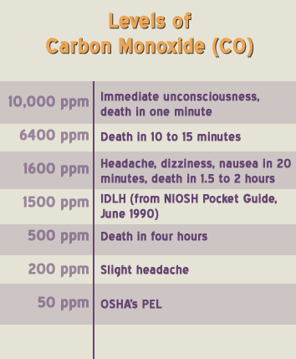
Toxic Effects CO
Concentration of only 1,600 ppm fatal within hours
Even lower level exposures can result in death if there are underlying medical conditions, or when there are additional factors (such as heat stress)
Notes:
More toxic effects of CO- 1600 ppm is fatal. An example- guys digging pier holes. 60% of would be rescuers die in confined space.

Slide 33
Characteristics of Hydrogen Sulfide
H₂S is a mitochondrial poison that prevents utilization of oxygen during cellular respiration, shutting down power source for many cellular processes
Also binds to hemoglobin in red blood cells, interfering with oxygen transport
Exposure to H₂S occurs primarily by inhalation, but can also occur by ingestion (contaminated food) and skin (water and air)
Once taken into the body, it is rapidly distributed to various organs, including the central nervous system, lungs, liver, muscle, as well as other organs
Notes:
Pretty much everyone in the room has had H2S training. Most of us have seen this before. H2S does not give you much of a chance of living at certain levels. The misnomer is that “as long as I can smell it, it’s OK.”

Slide 34
Hydrogen Sulfide
Produced by anaerobic sulfur fixing bacteria
Especially associated with:
  Raw sewage
  Crude oil
  Marine sediments
  Tanneries
  Pulp and paper industry
Notes:
Where does H2S come from? Crude oil, and raw sewage is what we see mostly.

Slide 35
Characteristics of Hydrogen Sulfide
Half-life in air = 12 to 37 hours
Eventually breaks down in sunlight
During very cold and dry conditions, half-life can exceed 37 hours
Particularly dangerous in oil production areas subject to cold winter temperatures
Collects in pits, within protective berms, or in other low lying areas
Notes:
The important note of this slide is: H2S is particularly dangerous in oil production areas subject to cold winter temperatures. The colder and more still the air is, gives H2S the chance to settle and not disperse.

Slide 36
Characteristics of Hydrogen Sulfide
Colorless
Smells like “rotten eggs” (at low concentrations)
Heavier than air
Corrosive
Flammable (LEL is 4.3 %)
Soluble in water
Extremely toxic!
Notes:
Characteristics of Hydrogen Sulfide- it is colorless, smells like rotten eggs, it’s extremely corrosive. It is flammable, but we would already be dead.

Slide 37
Toxic effects H2S
1.0 PPM
Smell
100 PPM
Rapid loss of smell
200 – 300 PPM
Eye inflammation, respiratory tract irritation after 1 hour, loss of consciousness with time
500 – 700 PPM
Death in 30 min. – 1 hr.
1000 PPM
Immediate respiratory arrest, loss of consciousness, followed by death
Notes:
Toxic effects H2S- This is why we can’t use our sense of smell. It destroys your olfactory senses. You can not smell it above 50-75 ppm.

Slide 38
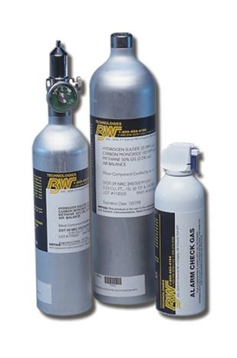
Calibration, Bump Testing and Verification
Calibration: The adjustment of an instrument’s response to match a desired value compared to a known concentration of test gas.
Bump test: Briefly applying gas to check that each sensor responds to target gas and that the alarms are working.
Calibration Verification: - A bump test utilizing a known concentration of a challenge gas to demonstrate that an instrument’s alarms are activated and the response to the gas is within acceptable limits.
DOCUMENT ALL TESTING……IF IT WASN’T DOCUMENTED IT DIDN’T HAPPEN
Notes:
Calibration, Bump Testing and Verification- The calibration of the sensors installed in gas detectors must be verified on a regular basis. Bump testing a monitor before each day’s use is the best safety practice. If you aren’t doing this, you are setting yourself up for trouble. A bad O2 sensor will pass a calibration, but won’t pass a bump test. What is another way to test an O2 sensor, if you don’t have bump gas? You can blow into it, until enough O2 is displaced, setting the monitor into alarm. O2 deficiency kills more people than toxic or combustible gases.

Slide 39
Manufacturer Guidelines
OSHA holds instrument users accountable to maintain, calibrate and operate their instruments according to manufacturer guidelines
https://www.osha.gov/dts/shib/shib093013.html
Notes:
OSHA holds instrument users accountable to maintain, calibrate and operate their instruments according to manufacturer guidelines

Slide 40
Bump Testing
The safest course of action is to expose the sensors to known concentration test gas before each day’s use!
Prudent to perform a bump test anytime a detector changes custody
Bump test any time a sensor has been exposed to a gas concentration that exceeds the detection range
Bump test any time there is doubt regarding the response of a safety gas detector
This test is very simple and takes only a few seconds to accomplish!
Notes:
Most manufacturers stress the importance of frequently verifying the calibration of their instruments. Most manufacturers strongly prefer that their customers verify the calibration of the sensors in their instruments by exposing them to known concentration test gas before any daily period of use. This is by far the safest and most prudent course of action. It really only takes a minute or so in most cases to verify whether or not the sensors in the instrument are properly calibrated. {[Knock a monitor on the podium]} This is not a bump test!
A self test does not replace a bump test. This is only checking the electronic integrity of the monitor, circuitry, and sensors.

Slide 41
When to Calibrate?
Functional “bump” test only provides verification of sensor performance
Calibration includes adjustment
Only necessary to adjust sensor sensitivity if readings are off
Most manufacturers recommend adjustment if readings are off by more than 10% of expected values
The BW Technologies by Honeywell factory default calibration interval is 180days
Notes:
OSHA states to follow manufacturer’s specs. We recommend calibrating at least every 180 days, or when a bump test fails. You should follow your company’s safety program.

Slide 42

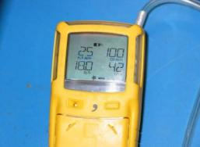
Don’t be afraid of calibration!
Modern designs make calibration easy and automatic
  All-In-One Calibration Mixtures Make Calibration and Functional Testing Easy!
  MicroDockII stations take all the guess work out of calibration, bump testing and record keeping
Notes:
Don’t be afraid to calibrate your gas detector. Nowadays, modern instruments frequently are able to make all the necessary adjustments by themselves. All you need to do expose the sensors to test gas. The instrument takes care of any necessary adjustment by itself.
Using a docking station is easier than ever, and it documents all bump tests and calibrations.

Slide 43

Questions?
Questions?
Answers.
Notes:
That’s all for my presentation. Are there any questions?

